Slide 1
Java Basics 7
Guangjian Zhou

Slide 2
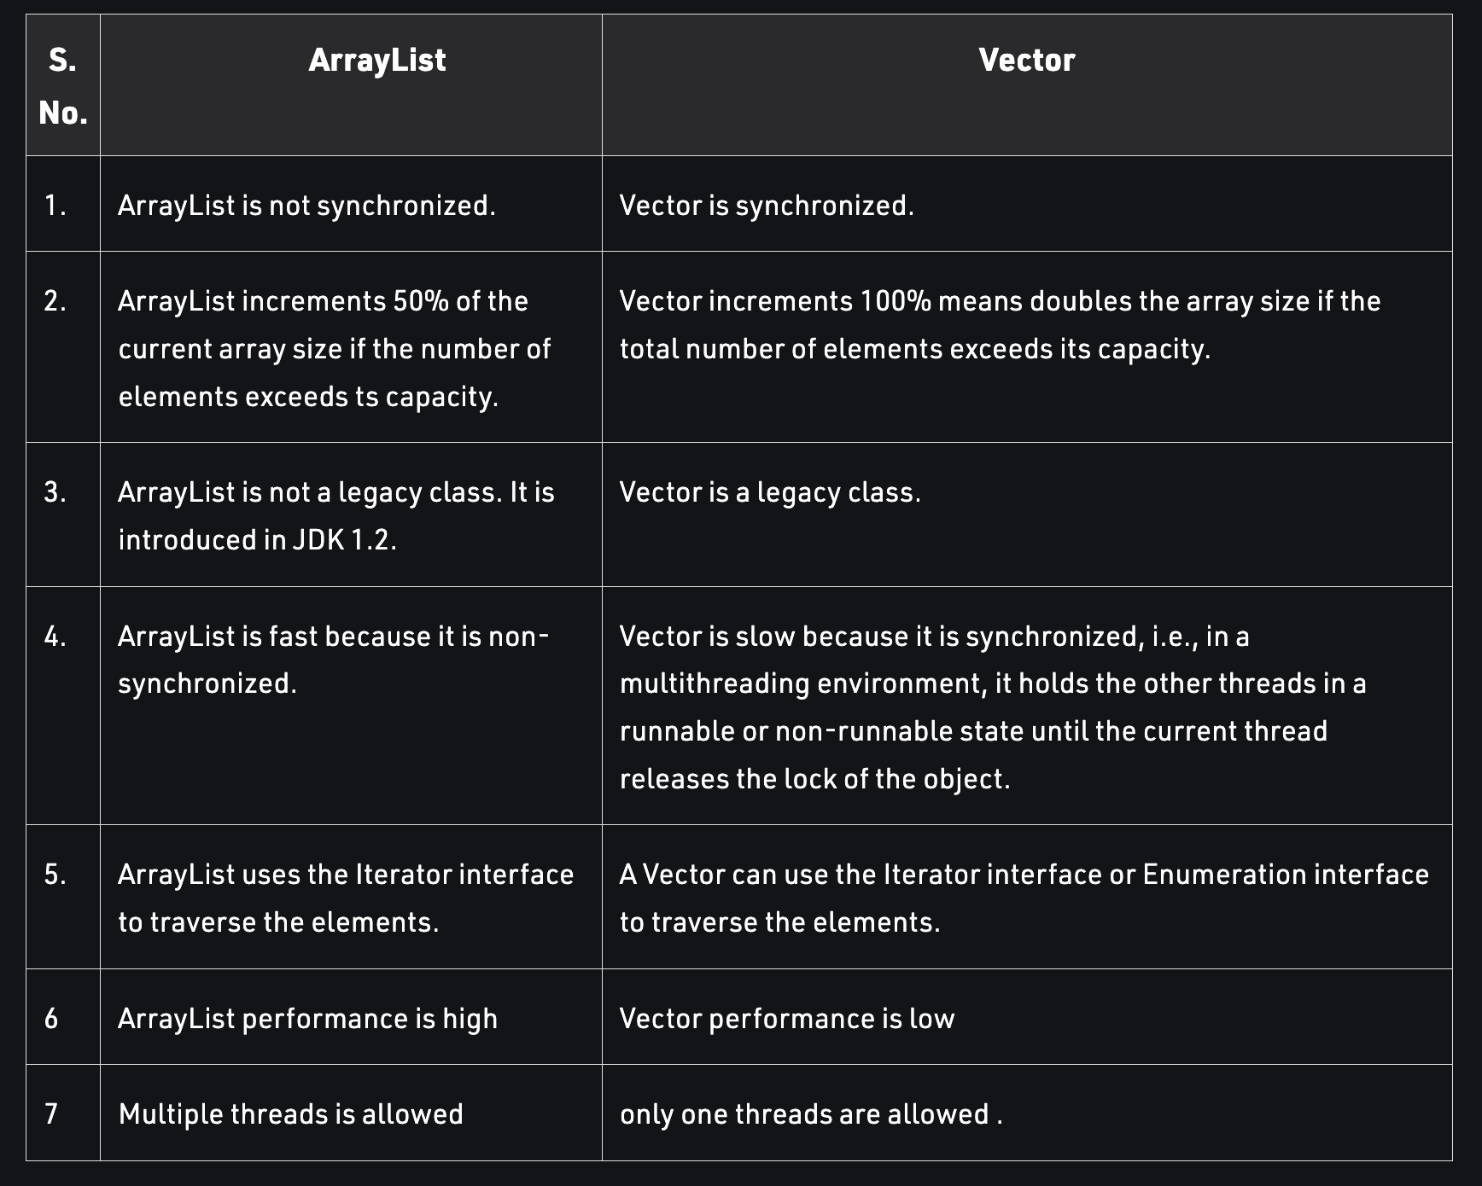
156.What are the differences between the two data structures: a Vector and an ArrayList?

Slide 3
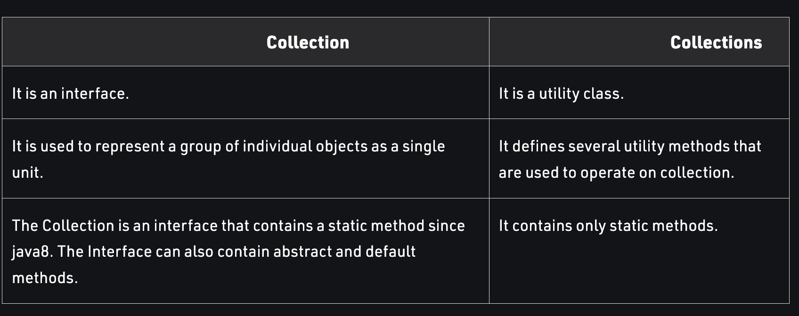
157.What are the differences between Collection and Collections in Java?

Slide 4
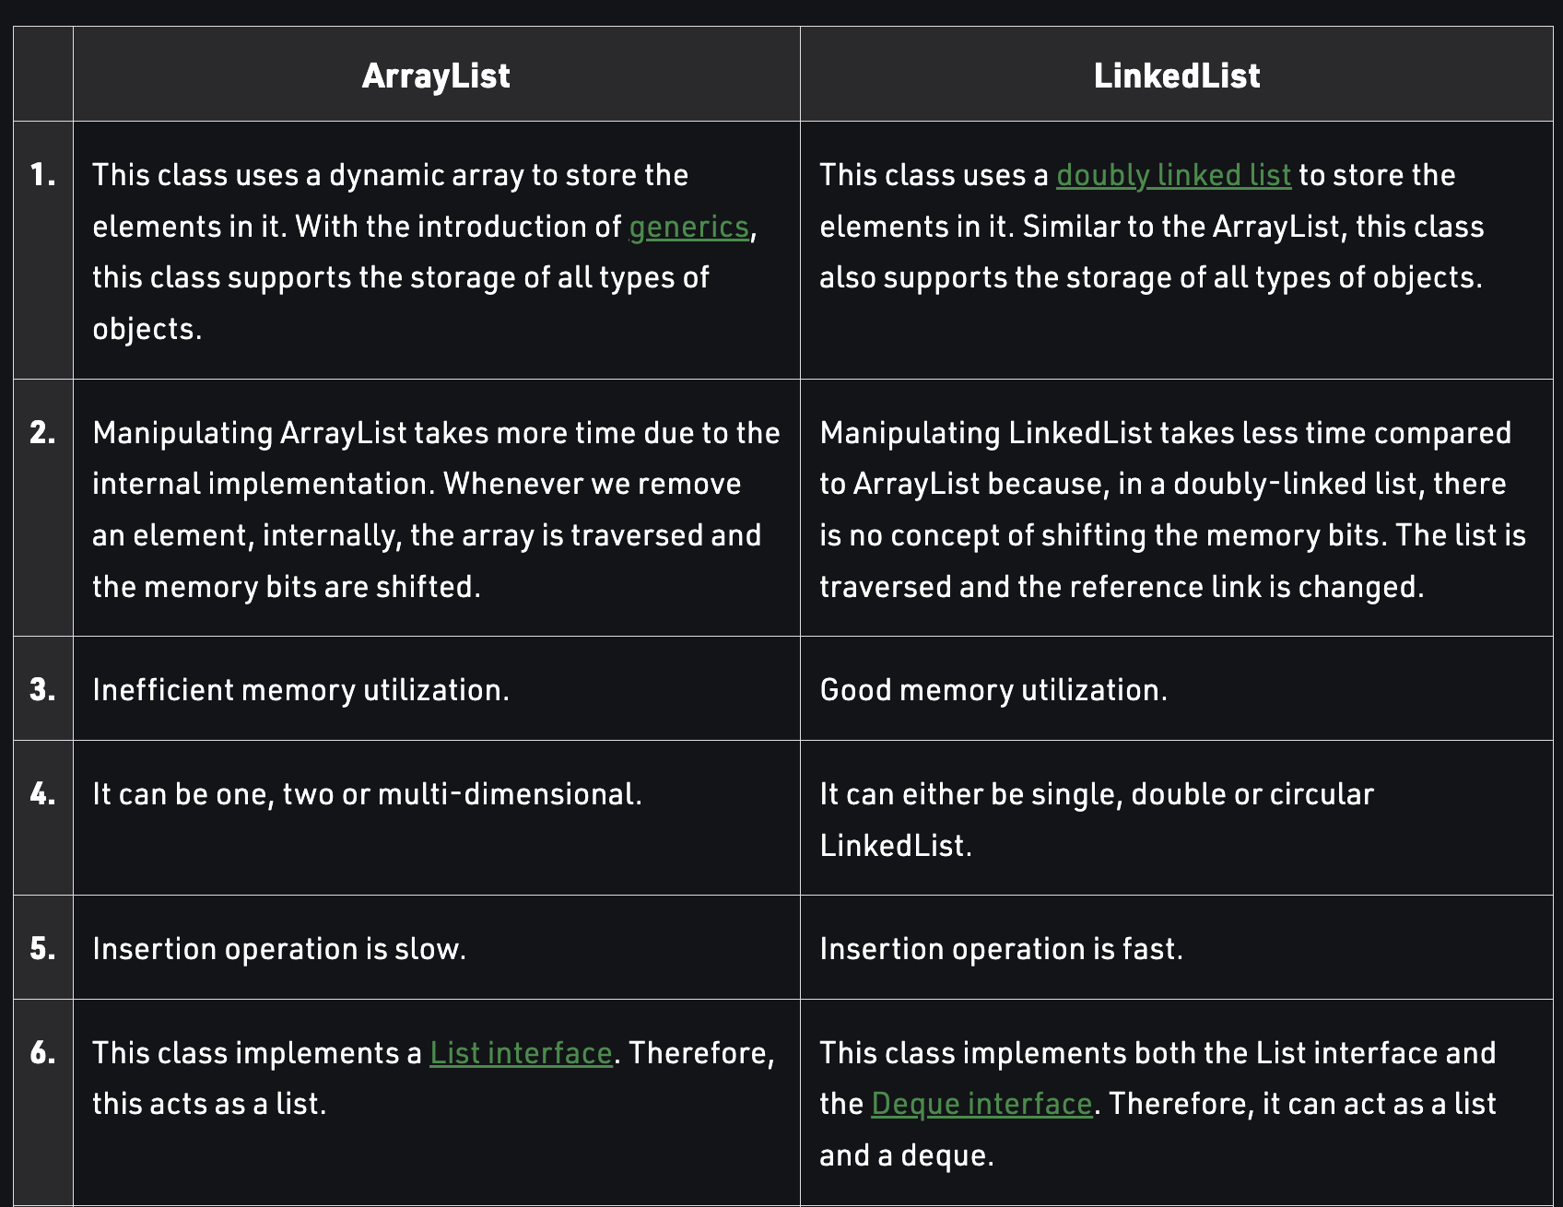
158.In which scenario, LinkedList is better than ArrayList in Java?

Slide 5
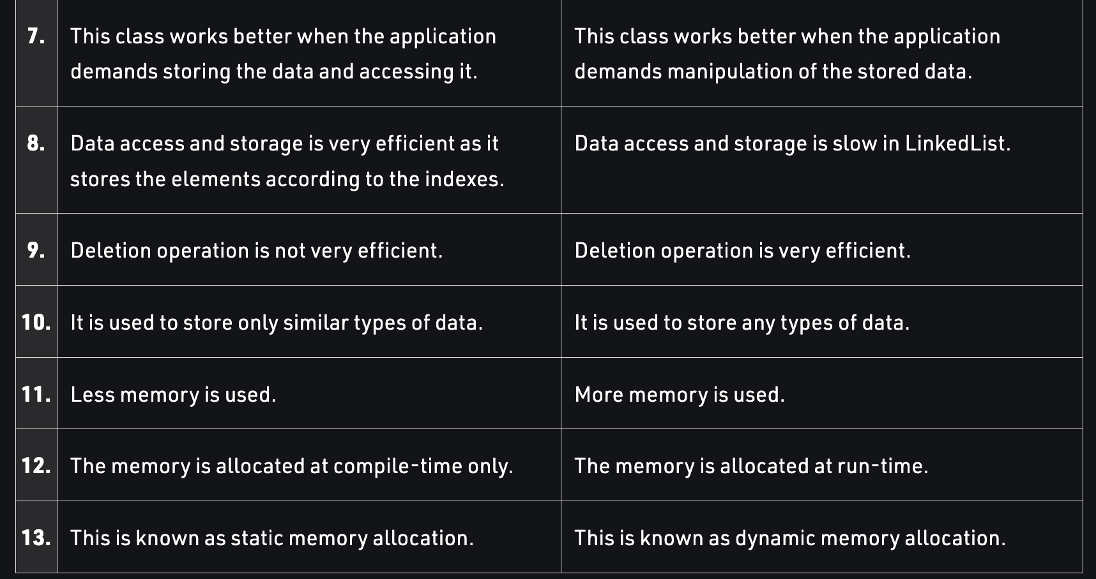
158.In which scenario, LinkedList is better than ArrayList in Java? Cont’d

Slide 6
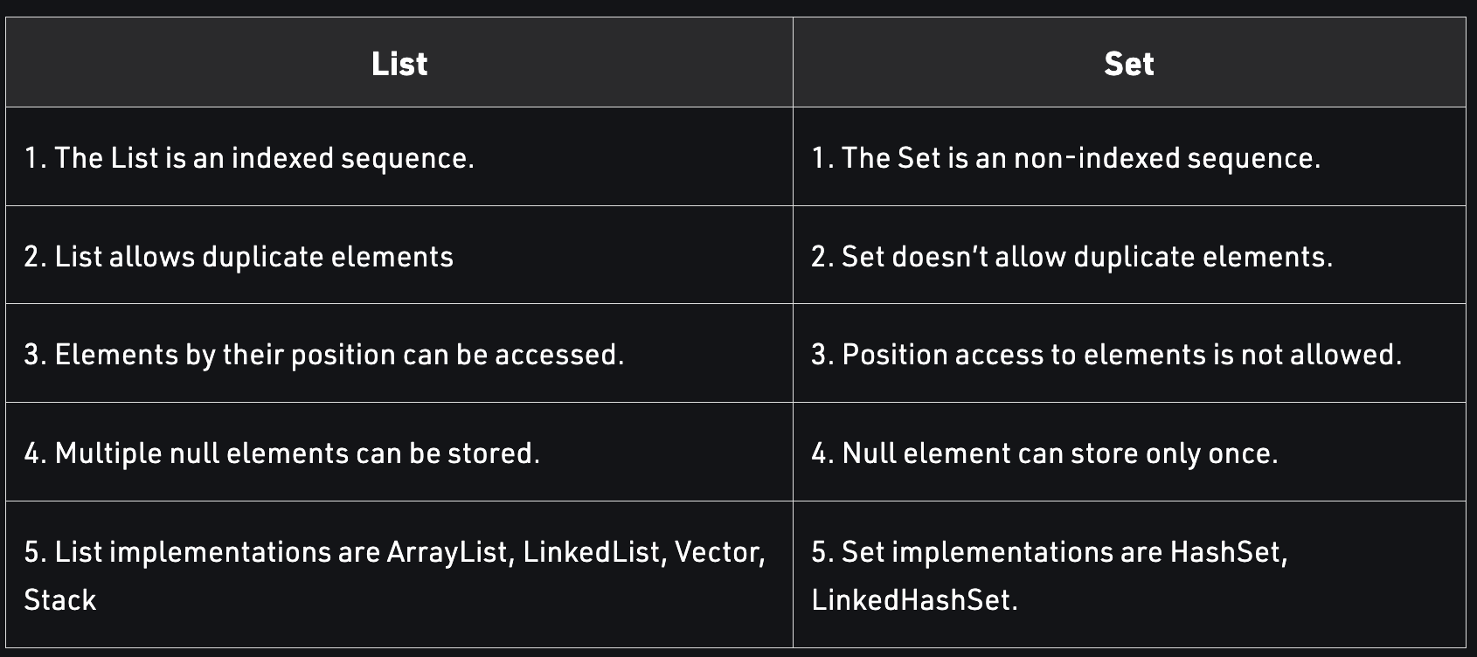
159.What are the differences between a List and Set collection in Java?

Slide 7
160.What are the differences between a HashSet and TreeSet collection in Java?
Features | HashSet | TreeSet
Internet working | HashSet internally uses HashMap for storing objects | TreeSet uses TreeMap internally to store objects
When To Use | If you don’t want to maintain insertion order but want to store unique objects | If you want to sort the elements according to some Comparator then use TreeSet
Order | HashSet does not maintain insertion order | While TreeSet orders the elements according to supplied Comparator. By default, objects will be placed according to their natural ascending order.
Complexity of Operations | HashSet gives O(1) complexity for insertion, removing, and retrieving objects | While TreeSet gives the performance of order O(log(n)) for insertion, removing, and retrieving operations.
Performance | The performance of HashSet is better when compared to LinkedHashSet and TreeSet. | TreeSet performance is better than LinkedHashSet except for insertion and removal operations because it has to sort the elements after each insertion and removal operation.

Slide 8
160.What are the differences between a HashSet and TreeSet collection in Java?
Features | HashSet | TreeSet
Compare | HashSet uses equals() and hashCode() methods to compare the objects | TreeSet uses compare() and compareTo() methods to compare the objects
Null Elements | HashSet allows only one null value. | TreeSet does not permit null value. If you insert null value into TreeSet, it will throw NullPointerException.
Syntax | HashSet obj = new HashSet(); | TreeSet obj = new TreeSet();

Slide 9
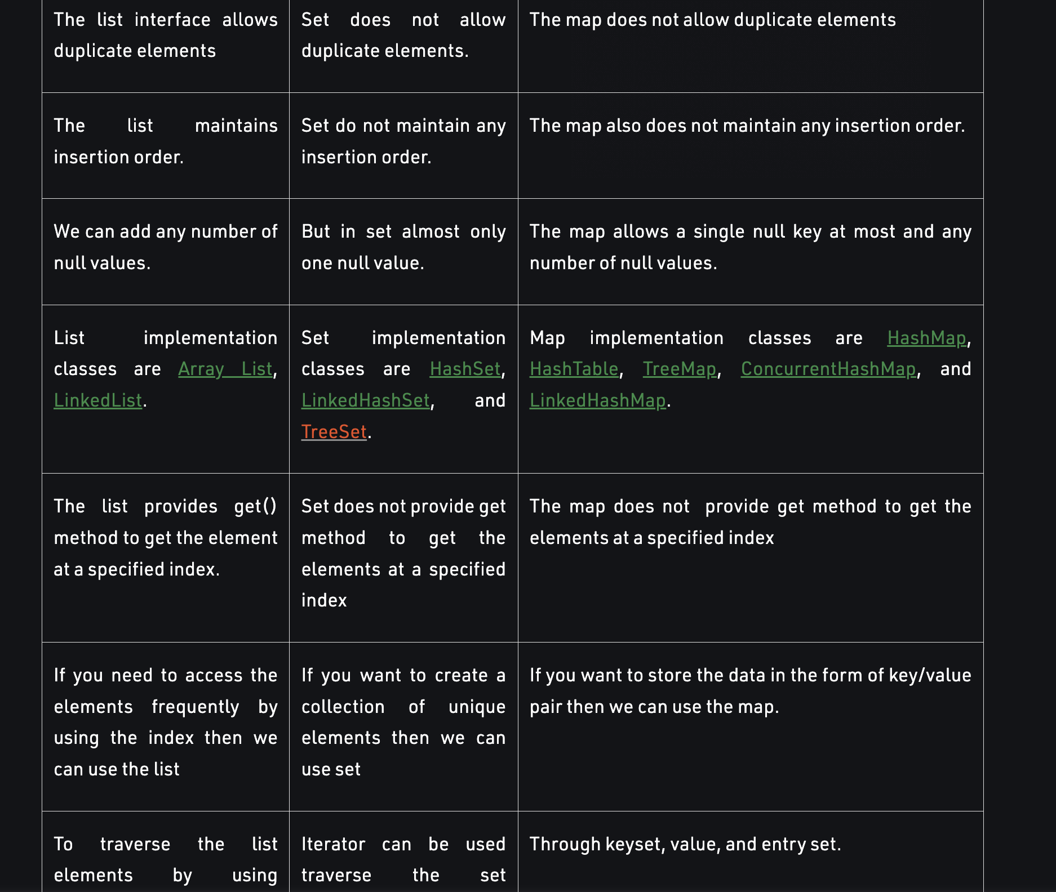
161. In Java, how will you decide when to use a List, Set or a Map collection?

Slide 10
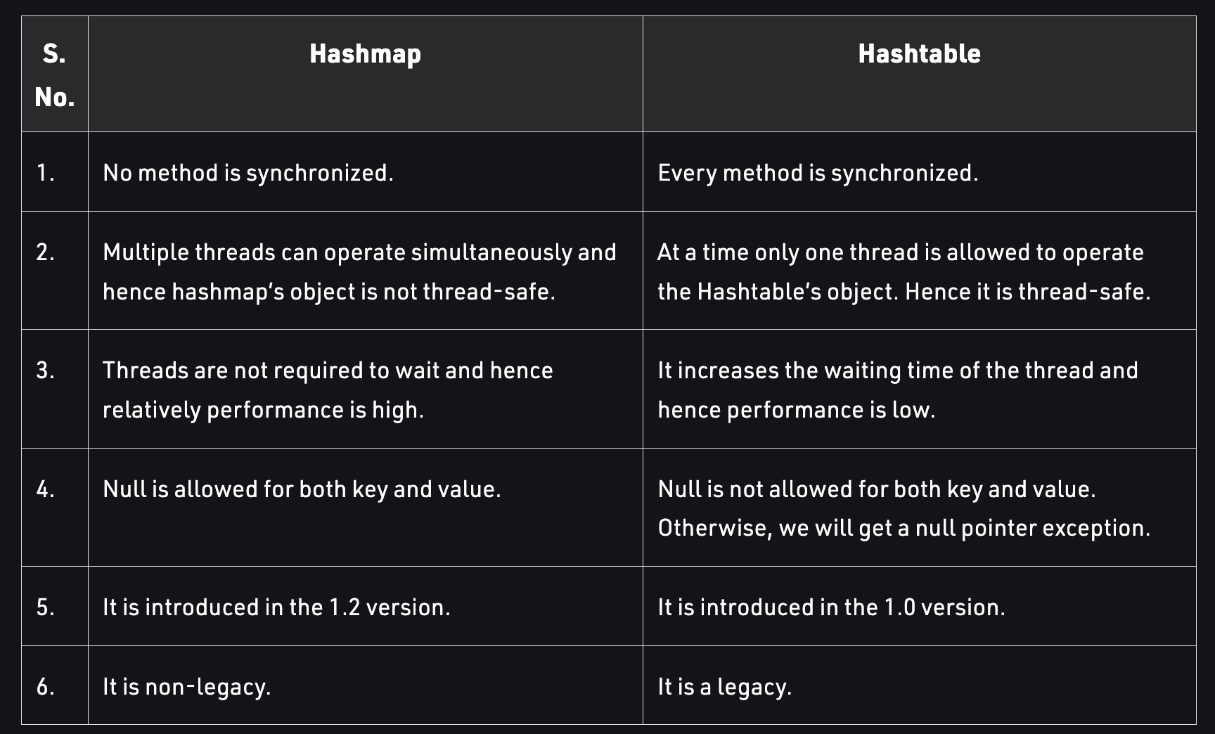
162.What are the differences between a HashMap and a Hashtable in Java?

Slide 11
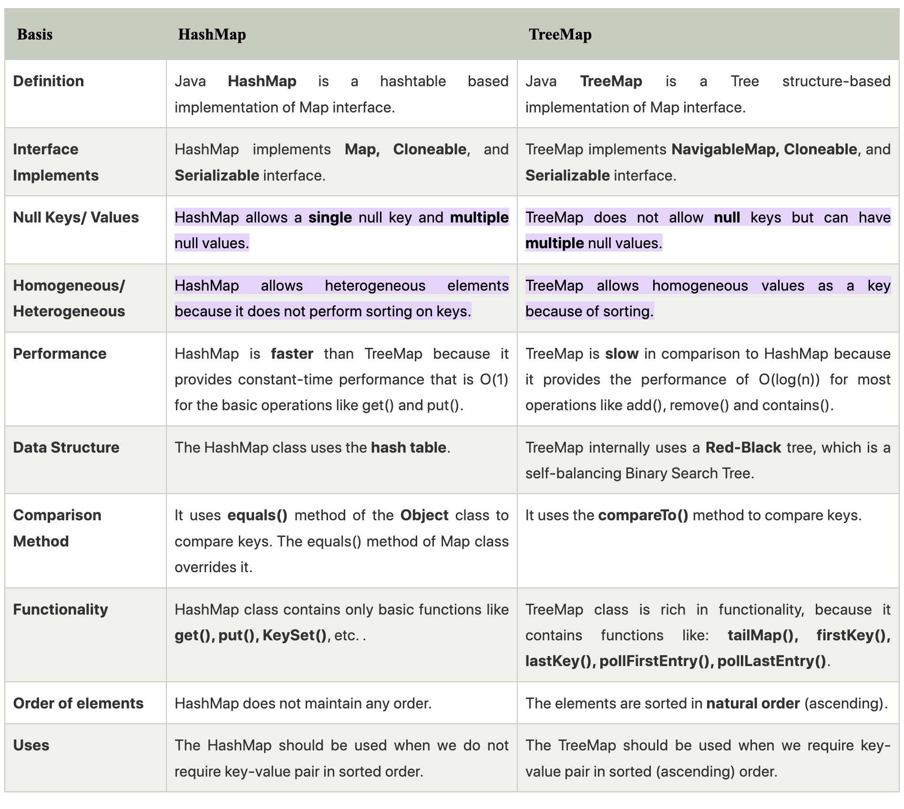
163.What are the differences between a HashMap and a TreeMap?

Slide 12
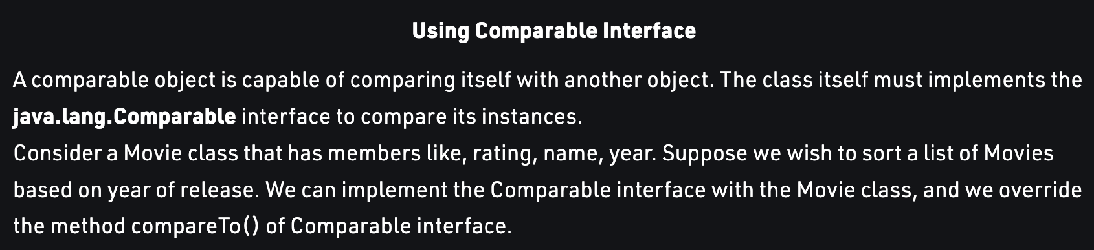
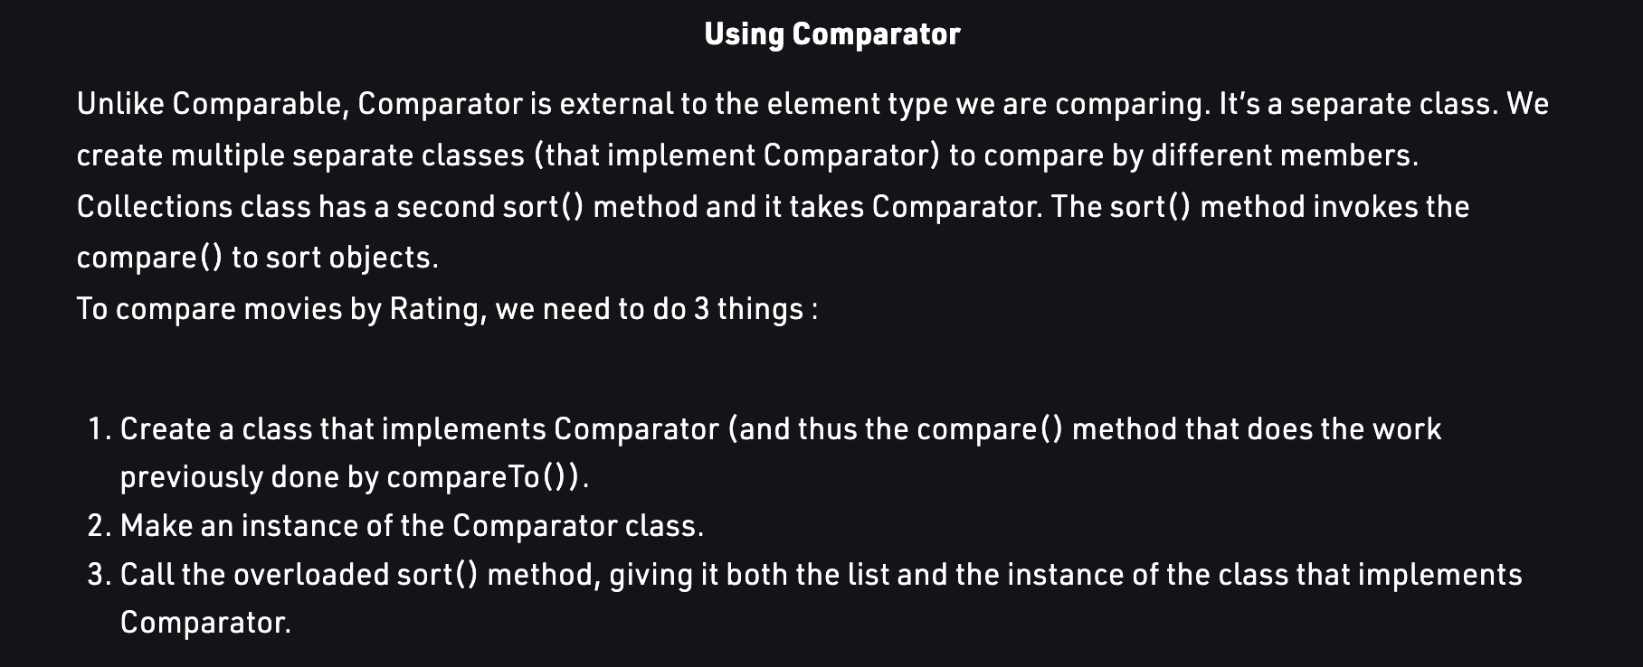
164.What are the differences between Comparable and Comparator?

Slide 13
165.In Java, what is the purpose of Properties file?

Slide 14
166.What is the reason for overriding equals() method?

Slide 15
167.How does hashCode() method work in Java?

Slide 16
168.Is it a good idea to use Generics in collections?

Slide 17
What is maven?

Slide 18
Important commands in maven?

Slide 19
What is pom.xml ?

Slide 20
18.What is packaging available?

